Slide 1
Weekend Leader Preparedness
The Weekend Leader Journey: Navigating Leadership Beyond Just Choosing a Driver

Slide 2
Thoughts on Leadership
“Good leaders create followers, but great leaders create leaders.” -Rachel Kohn, 2004
“Good leaders have vision and inspire others to help them turn vision into reality. Great leaders create more leaders, not followers. Great leaders have vision, share vision, and inspire others to create their own.”
Notes:
Include opening prayer

Slide 3
Devotional
But the Lord said to Samuel, “Do not consider his appearance or his height, for I have rejected him. The Lord does not look at the things people look at. People look at the outward appearance, but the Lord looks at the heart.”
1 Sam 16:7
Notes:
Give a comparison of what the worldly version of leadership looks like, compare with it holds up to the Biblical version

Slide 4
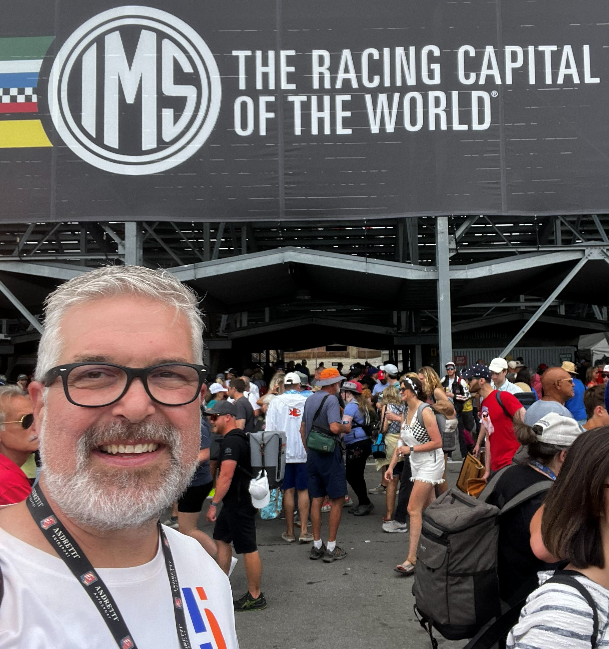
Darrell Whinnery
Resides in Indianapolis, IN
Husband, father, physician assistant
Joined Kairos Outside in 2009, also served Kairos Inside, Kairos Torch
Currently Kairos International Council Inside subcommittee co-chair
Has served as Kairos Inside Weekend Leader, Advisory Council Chair, State Chair

Slide 5
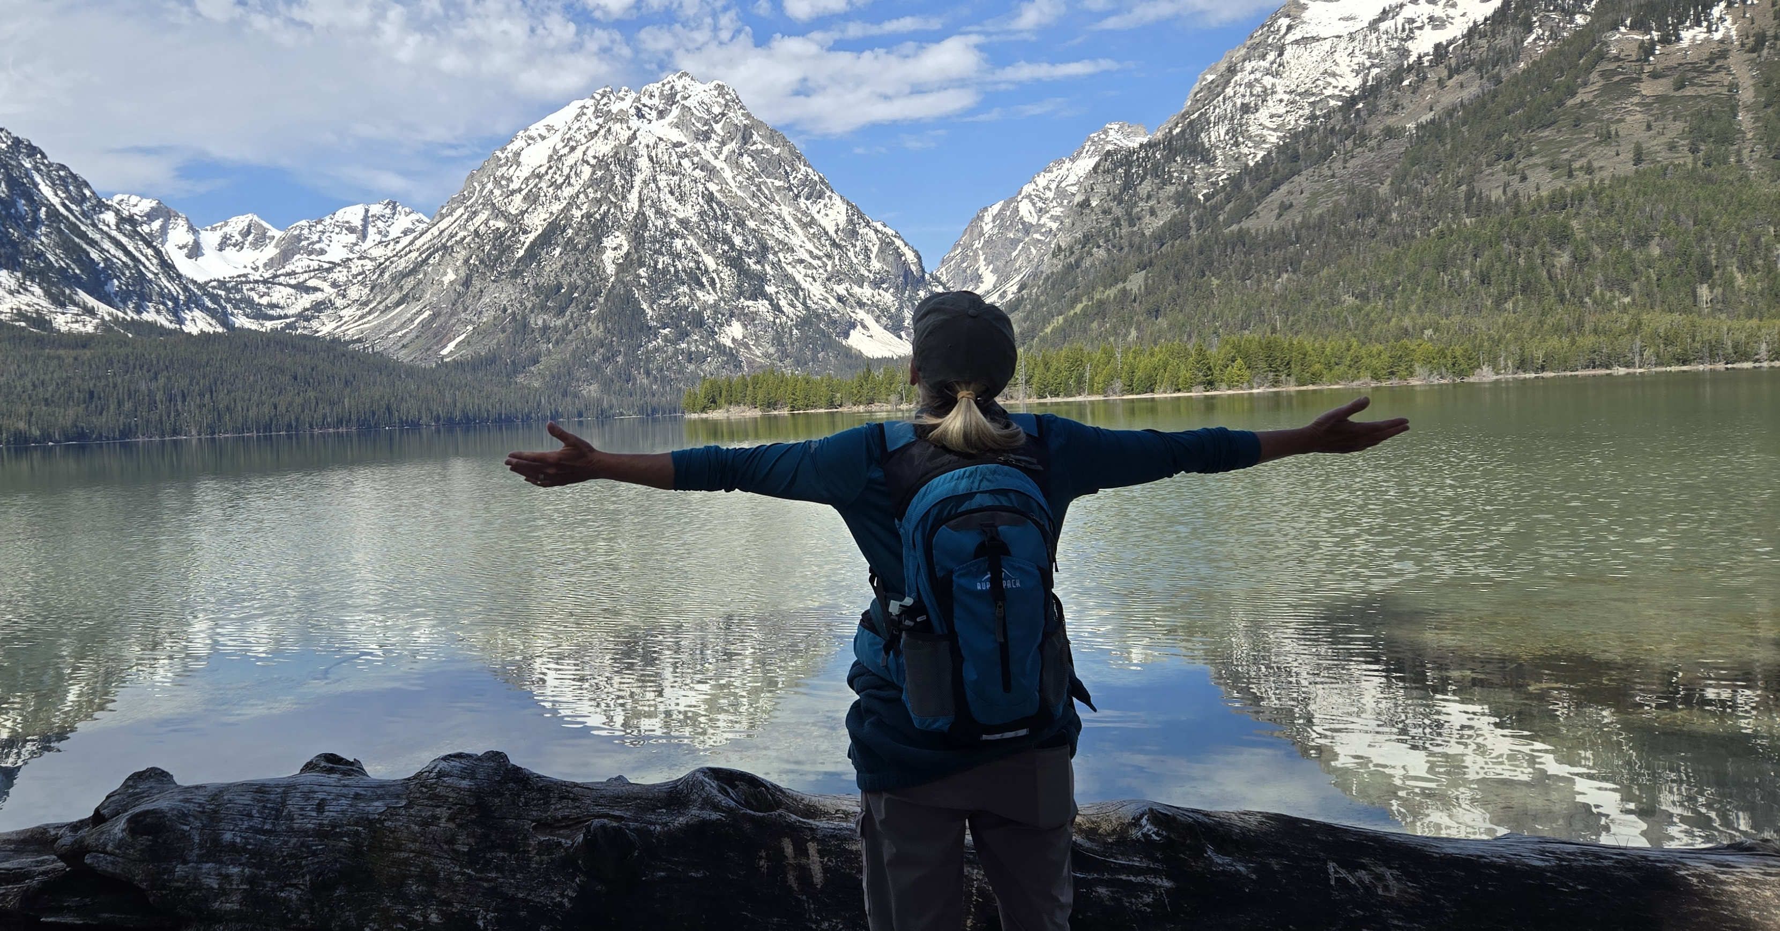
Sheila Cooley
Resides in Canton, CT
Wife and mother, grandmother, empty nester
Joined as Kairos Inside volunteer in 2017, migrated to Kairos Outside in 2022
Served as Advisory Council Chair, Donor Coordinator, Weekend Leader
Enjoys cycling, hiking, and national parks

Slide 6
The Weekend Leader Journey
Know Your Destination
Planning the Route
Packing the Car
Reaching the Destination
On the Road
Choosing the Right Driver
Notes:
In the same way any successful journey requires wisdom, preparation, and execution so does the Weekend Leader’s journey.

Slide 7
I. Know Your Destination
Understanding vision and mission
Importance of unified vision
Alignment within the Kairos mission
Notes:
How can you plan a trip if you don’t know where you’re going. (READ THE MISSION, VISION STATEMENTS AS ALL SHOULD DO AT EVERY MEETING) Does the Advisory Council as well as the Weekend Leader understand the vision and mission of Kairos? Everyone needs to be traveling toward the same destination. Is your Advisory Councils vision united and in alignment with the Kairos mission?

Slide 8
I. Know Your Destination
Kairos Program Manual (PM)
Advance Kairos Training (AKT)
Ezra tools and training resources
Department of Corrections (DOC) Guidelines
Facility/venue information for Kairos Outside
Notes:
I thought I knew everything after AKT. Tools like PM, AKT and Ezra will keep Advisory Council, Weekend Leader and Team inside the Riverbanks of your Journey long before you hit the guardrails of the DOC guidelines. Make sure everyone in the car knows and understands the rules of the DOC and host facility/venue. Lead with excellence and resist those who want to do it “the way we’ve always done it.” Many resources on mykairos.org

Slide 9
Key Takeaway
Effective leadership requires clear direction from the outset
Know Your Destination
Notes:
In order for the journey to be successful, the Weekend Leader, with the support and guidance of the AC, needs to understand the mission & vision (so that the rest of the planning and execution support the mission).

Slide 10
II. Choosing the Right Driver
Why Leader Selection Matters
Based on spiritual maturity and integrity
Participation in continuing ministry and accountability groups
Demonstrates servant leadership not self promotion

Slide 11
II. Choosing the Right Driver
Qualities and Criteria of Leaders
Leads by example, not control
Builds relationship and unifies the team
Communicates clearly and delegates effectively
Humble, grateful, and God confident (not self-confident)
Criteria on p 44-45 Outside, 71-72 Inside & 51-53 Torch PMs
Notes:
Eph 4:2

Slide 12
II. Choosing the Right Driver
Willingness vs Readiness
Leaders emerge from qualified, committed team members
Recruiting and developing future leaders is ongoing
Important truth: not every willing person is ready
(just like not everyone is suited to drive long distances)
Notes:
The criteria has been spelled out in the program manual, and you want to ensure that leaders have shown commitment to continuing ministry as well as Weekends but remember God’s words to Samuel when he anointed David as king. Spiritual discernment is needed. Keep eye out for potential future leaders and find ways to encourage & develop them.

Slide 13

II. Choosing the Right Driver
Spiritual Maturity?
Personal Support System?
Dealing with Stress?
Taking Advice?
Build Community
Encourage Delegation
Support Faith Walk
Self-Assessment
Peer Feedback
Notes:
Potential leaders need to be self-aware and only accept the role if they are called. Their peers, the AC, should guide them, encourage them, and cheer them on. Does the leader feel inward desire? does the AC give outward confirmation? Is there an open door (meet the criteria, etc.)?

Slide 14
Key Takeaway
Choosing the right Weekend Leader is critical!
Choosing the Right Driver
Notes:
Before asking a Weekend Leader to assume the role, we must ensure they are properly oriented, equipped, and prepared to carry out their responsibilities with confidence and success.

Slide 15
III. Planning the Route:
Supporting the Leaders: Advisory Council Planning
Spiritual Preparation
Mentoring
Team Selection
Notes:
A good driver still needs a map and directions (Or GPS!), such as previously mentioned tools of PM, Ezra and DOC guidelines. The Advisory Council should be the “trip planners,” and prepare and guide the Weekend Leader, and ensure alignment with Kairos principles. Maybe the most important role of the Advisory Council is to provide a called and qualified pool of Team candidates and support the selection process, spiritually prepare the Team Leaders, and prepare the Leaders through prayer and encouragement.

Slide 16
III. Planning the Route
Supporting the Leaders: Financial & Logistical Considerations
Financial
Logistical
Budgeting framework that can help team stay accountable; create a budget review meeting to assess financial health
Adequate volunteers and materials
Notes:
Like budgeting any trip, count the cost before embarking (Luke 14:28-30). What are your financial resources, materials, logistics and readiness of team and servants? The Advisory Council should budget with good stewardship and hold the Team accountable for spending. (Examples of spending on food and lodging.). Budget review meetings can help to assess financial health. Remember, it is everyone’s responsibility to fundraise and recruit and not just the Weekend Leader.

Slide 17
Key Takeaway
Success depends on proper preparation, tools, and support
Planning the Route
Notes:
When planning the route, Leaders need to be supported with recruitment and selection assistance, financial and logistical support and accountability, and Leader preparation through spiritual preparation, mentoring and encouragement.

Slide 18
IV. Packing the Car
Team Composition: Team vetting
Spiritually grounded volunteers aligned with Kairos values
Committed to Weekend and Continuing Ministry
Team Diversity
Notes:
The team members are not just passengers but are the vehicle. Team members need to be loving, sacrificial, obedient, good stewards, demonstrate commitment. The composition should reflect as best as it can, the demographic it intends to serve.

Slide 19
IV. Packing the Car
Team Composition: Advisory Council’s Role
Continuous support and encouragement
Tools and Resources
Regular Follow-ups
System for Future Leadership
Notes:
Advisory council helps vet & approve team members; ensures proper mix & readiness; supports leader in difficult decisions. Including prayer support for leader & family to guard against burnout & spiritual attack

Slide 20
IV. Packing the Car
Team Composition: Preventative Maintenance
Follow the 3-on-1-off rule
Continuous Fundraising and Recruitment
Post-event Debriefs
Notes:
Follow the Kairos prescribed rhythms to ensure against burnout or permitting certain individuals, no matter how good or qualified, to dominate. (Even Jesus entrusted His early church to others). Fundraising & recruiting efforts need to be ongoing and shared. Train all team members so they are comfortable in participating in these efforts.

Slide 21
IV. Packing the Car
Team Composition: Advisory Council Training Meetings
Core Team Training
Advisory Council meetings pre and post Weekend
Notes:
This can be done in many ways, such as during Advisory Council meetings before and after the Weekend (the Weekend Leader should be present at all Advisory Council meetings before and after the Weekend to update and receive support) and assistance with Core Team training (examples?). I highly recommend starting Core Team Meetings early!

Slide 22
Key Takeaway
A successful journey requires a well prepared, fully supported team
Packing the Car
Notes:
Advisory Council helps vet and approve team members, ensures proper mix and readiness of Team Members and supports Leaders in difficult decisions.

Slide 23
V. On the Road
Weekend Support: Contingency Planning
Conflict resolution strategies
Emergency response planning
Consequences of neglect
Notes:
Handling “car trouble:” The Advisory Council and Advising Leader provide guidance when issues arise and help the Weekend Leader stay aligned with the mission. Have a contingency plan for unexpected challenges or conflicts along the way and establish a quick-response team for urgent decisions. (Ex.: Adhere to 75% attendance during Team Formation so interpersonal difficulties are resolved BEFORE the Weekend, have a way to contact someone outside the facility who is prepared to assist, have copies of talks so another Team Member can do a talk if a speaker no-shows, etc. ). (Consequences of neglect?)

Slide 24
V. On the Road
Weekend Support: Advisor Council Support
Ongoing prayer support
Encouragement and spiritual covering
Notes:
Every journey requires refueling along the way. This is done on the Weekend through ongoing prayer, encouragement and trusting in the Wisdom of Kairos (Ex.: ensuring obedient to the PM and Ezra).

Slide 25
Key Takeaway
Even the best planned trip requires support along the way
On the Road
Notes:
The trip is underway but the role of the Advisory Council does not end. Even the best-planned trip requires support along the way. But the Weekend is finally here, so remember to enjoy the ride!

Slide 26
VI. Reaching the Destination
Celebrating the Journey: Closing Ceremony
Acknowledge contributions of Leader, team and community
Continuing Ministry and new volunteer opportunities

Slide 27
VI. Reaching the Destination
Celebrating the Journey: Post-Trip Responsibilities
Financial Reconciliation
Kairos Reporting
Sharing Testimonies and Impact

Slide 28
Key Takeaway
The journey doesn’t end at the destination;
care and follow-through matter.
Reaching the Destination

Slide 29
Closing Thoughts
A successful road trip requires
A Clear Map (manuals, tools, resources)
The Right Driver (Leader)
Reliable Vehicle (team)
Ongoing Support (Advisory Council and prayer)
Celebrating the Journey! (Post weekend follow-up)
Support is Critical
Avoid Burnout
Ensure teams are effective
Take advantage of mission opportunities
Multiply leaders, not just complete Weekends
Strong support systems develop future leaders and strengthen ministry long-term
Know Your Destination
Choosing the Right Driver
Planning the Route
Packing the Car
Reaching the Destination
On the Road
Notes:
Support is critical: Do not focus only on selection! Choosing the right leader but providing no support leads to burnout, ineffective Teams and missed mission opportunities. The goal is not just to complete Weekends. Strong support systems will strengthen the Kairos Ministry long-term and will develop future leaders. Remember slide #2? Great leaders will identify servants with potential for leadership (and not just warm bodies), provide them with opportunities to gain experience, and mentor the future leaders of Kairos. Take Away for future Weekend Leaders: Like in the Matthew West song, you are not strong enough. Keep yourself and your spoused prayed-up, be grouping, stay humble, be willing to delegate and use your tools so you will lead with excellence, Final road trip analogy: You would not hand someone the keys for a cross-country trip without a map, a vehicle, gas or road-side assistance. In the same way, Kairos does not just need the right Weekend Leader-it needs to surround the Leader with preparation, tools, team and ongoing support to ensure the journey is successful and glorifying to God!

Slide 30

Questions & Answers
Discussion and participant questions
Closing Prayer

